Slide 1
Herefordshire Sexual Violence Strategy
2023-2028

Slide 2
Impact on health
Sexual violence crimes have devastating effects that are often lifelong and present in different ways, at different times, for different individuals. The Home Office has identified the following prominent impacts (HO, 2022):
Detrimental effects on mental health – Anger, frustration, decreased self-esteem, depression, anxiety, post-traumatic stress disorder and a loss of identity. •
Physical harm - Evidence suggests that women and girls who have been victims of these crimes engage in poorer health behaviours, including smoking, substance misuse and poor diet. FGM can result in long-term physical health complications.
Negative impacts on education, employment and finances – There may be impacts on victim and survivors’ educational attainment, employment and income prospects due to being absent from school or work or being unable to find and keep employment.
Making women feel less safe - The most recent statistics show that only 24% of women felt very safe walking alone after dark, in comparison to 46% of men (ONS, 2020a).

Slide 3
National & Herefordshire
Reported sexual violence offences have increased post COVID-19 compared with pre-pandemic levels (West Mercia Police, 2022).
Sexual violence is a hidden crime that is grossly under-reported. Estimates from the Crime Survey for England and Wales 2022 showed that 2.7% of adults aged 16 to 59 years experienced sexual assault in the last year in England and Wales. This would equate to an estimate of 5,049 sexual violence offences against adults aged 16 to 59 years in Herefordshire during a one year period. However, only 1105 offences were actually reported for all ages over a three year period (April 2019-March 2022).
Sexual violence disproportionately affects women and girls. Approximately 1 in 20 men (5.7%) have experienced sexual assault (including attempts) since age 16, compared to more than 1 in 4 women (27%) (ONS, 2021a).
Nationally, perpetrators are overwhelmingly male - 98% of people who report sexual violence say that the perpetrator was male (ONS, 2021a).
Perpetrators of reported offences are frequently not brought to justice. In 2019, 55,259 rapes were recorded nationally, but only 702 convictions were made (ONS, 2021a).
Advocacy and therapeutic interventions can have positive effects on victims’ and survivors’ well-being and engagement with the criminal justice system. However, awareness of available services is variable amongst victims and survivors and the wider system. Commissioned services themselves have capacity restrictions due to budgetary constraint.

Slide 4
Herefordshire
The Violence Against Women and Girls: Problem Profile Herefordshire (West Mercia Police, 2022) presents the picture of VAWG across the four spaces of: private, public, online and education between 01 April 2019 and 31 March 2022. It reports that:
• 1 in 5 of all offences were VAWG
• Within all spaces, there has been a substantial overall increase in offences post COVID-19 in comparison to pre-pandemic levels.
• 69% of VAWG offences were recorded as occurring in a private space. This was followed by public locations at 21%.
• 1105 (17%) of VAWG offences between 01 April 2019 and 31 March 2022 were of a sexual nature.
Violence and sexual offences in Herefordshire compared with similar areas (source: Police.uk) March 22

Slide 5
Background
DA act 2021- It is intended to increase awareness and inform the response to domestic abuse. It also conveys standards and promotes best practice.
A statutory definition of domestic abuse will help to do this, emphasising that domestic abuse is not just physical or sexual violence, but can also be emotional, coercive or controlling, and economic abuse

Slide 6
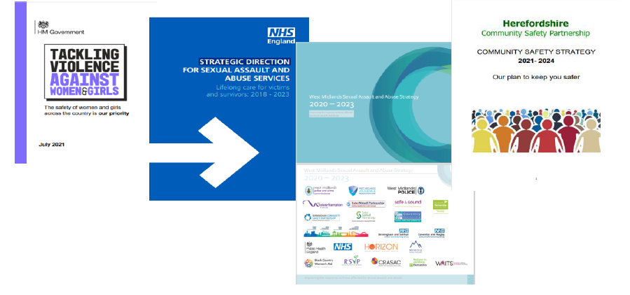
Our Strategy
Our vision is for a County where everyone lives free of the fear, threat, or experience of sexual violence. Our strategy focuses on three priority areas: prioritising prevention, supporting victims and survivors and pursuing perpetrators.

Slide 7
Our Strategy

Slide 8
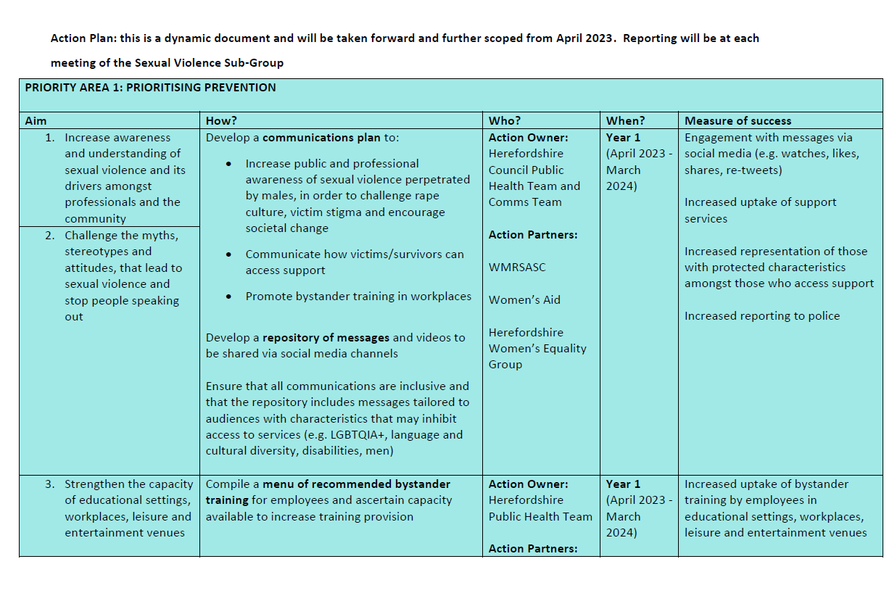
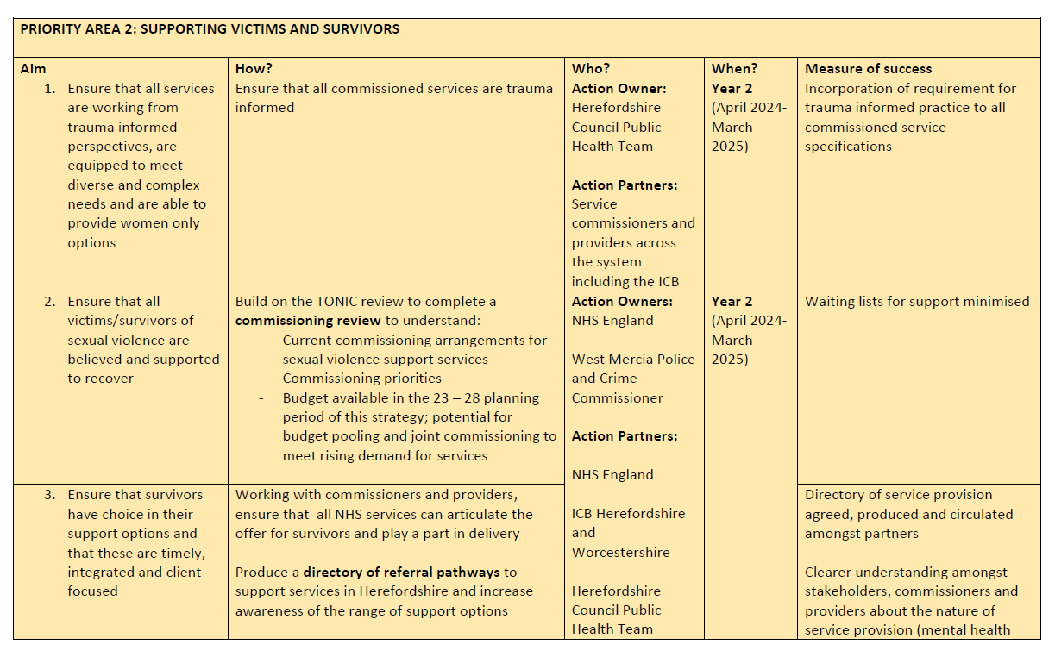
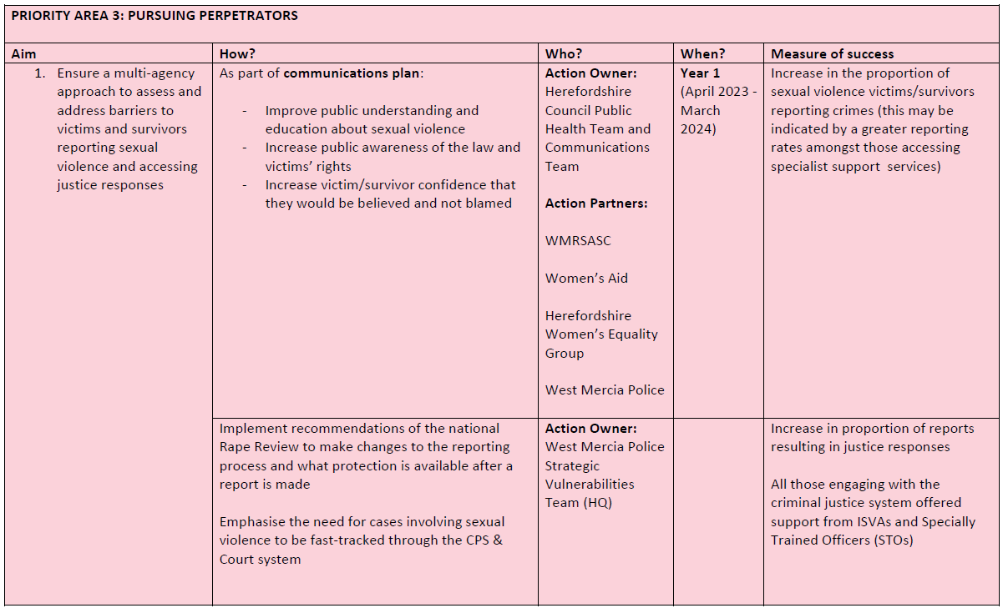
Action Plan
Our action plan is focussed on our three priority areas: Prioritising prevention, supporting victims and survivors and pursuing perpetrators.
Min data set & comms plan

Slide 9
Experience of chairing group
Healthy relationships task and finish group
Supporting and aligning work streams with partners
SV awareness training
Passionate and dedication
Continue working through action plan, using data and comms plan to enhance

Slide 10

Why we need a Strategy and a Response
Article 3 of the Human Rights Act 1998
‘No one should be subject to torture or to inhumane or degrading treatment or punishment.’

Slide 11
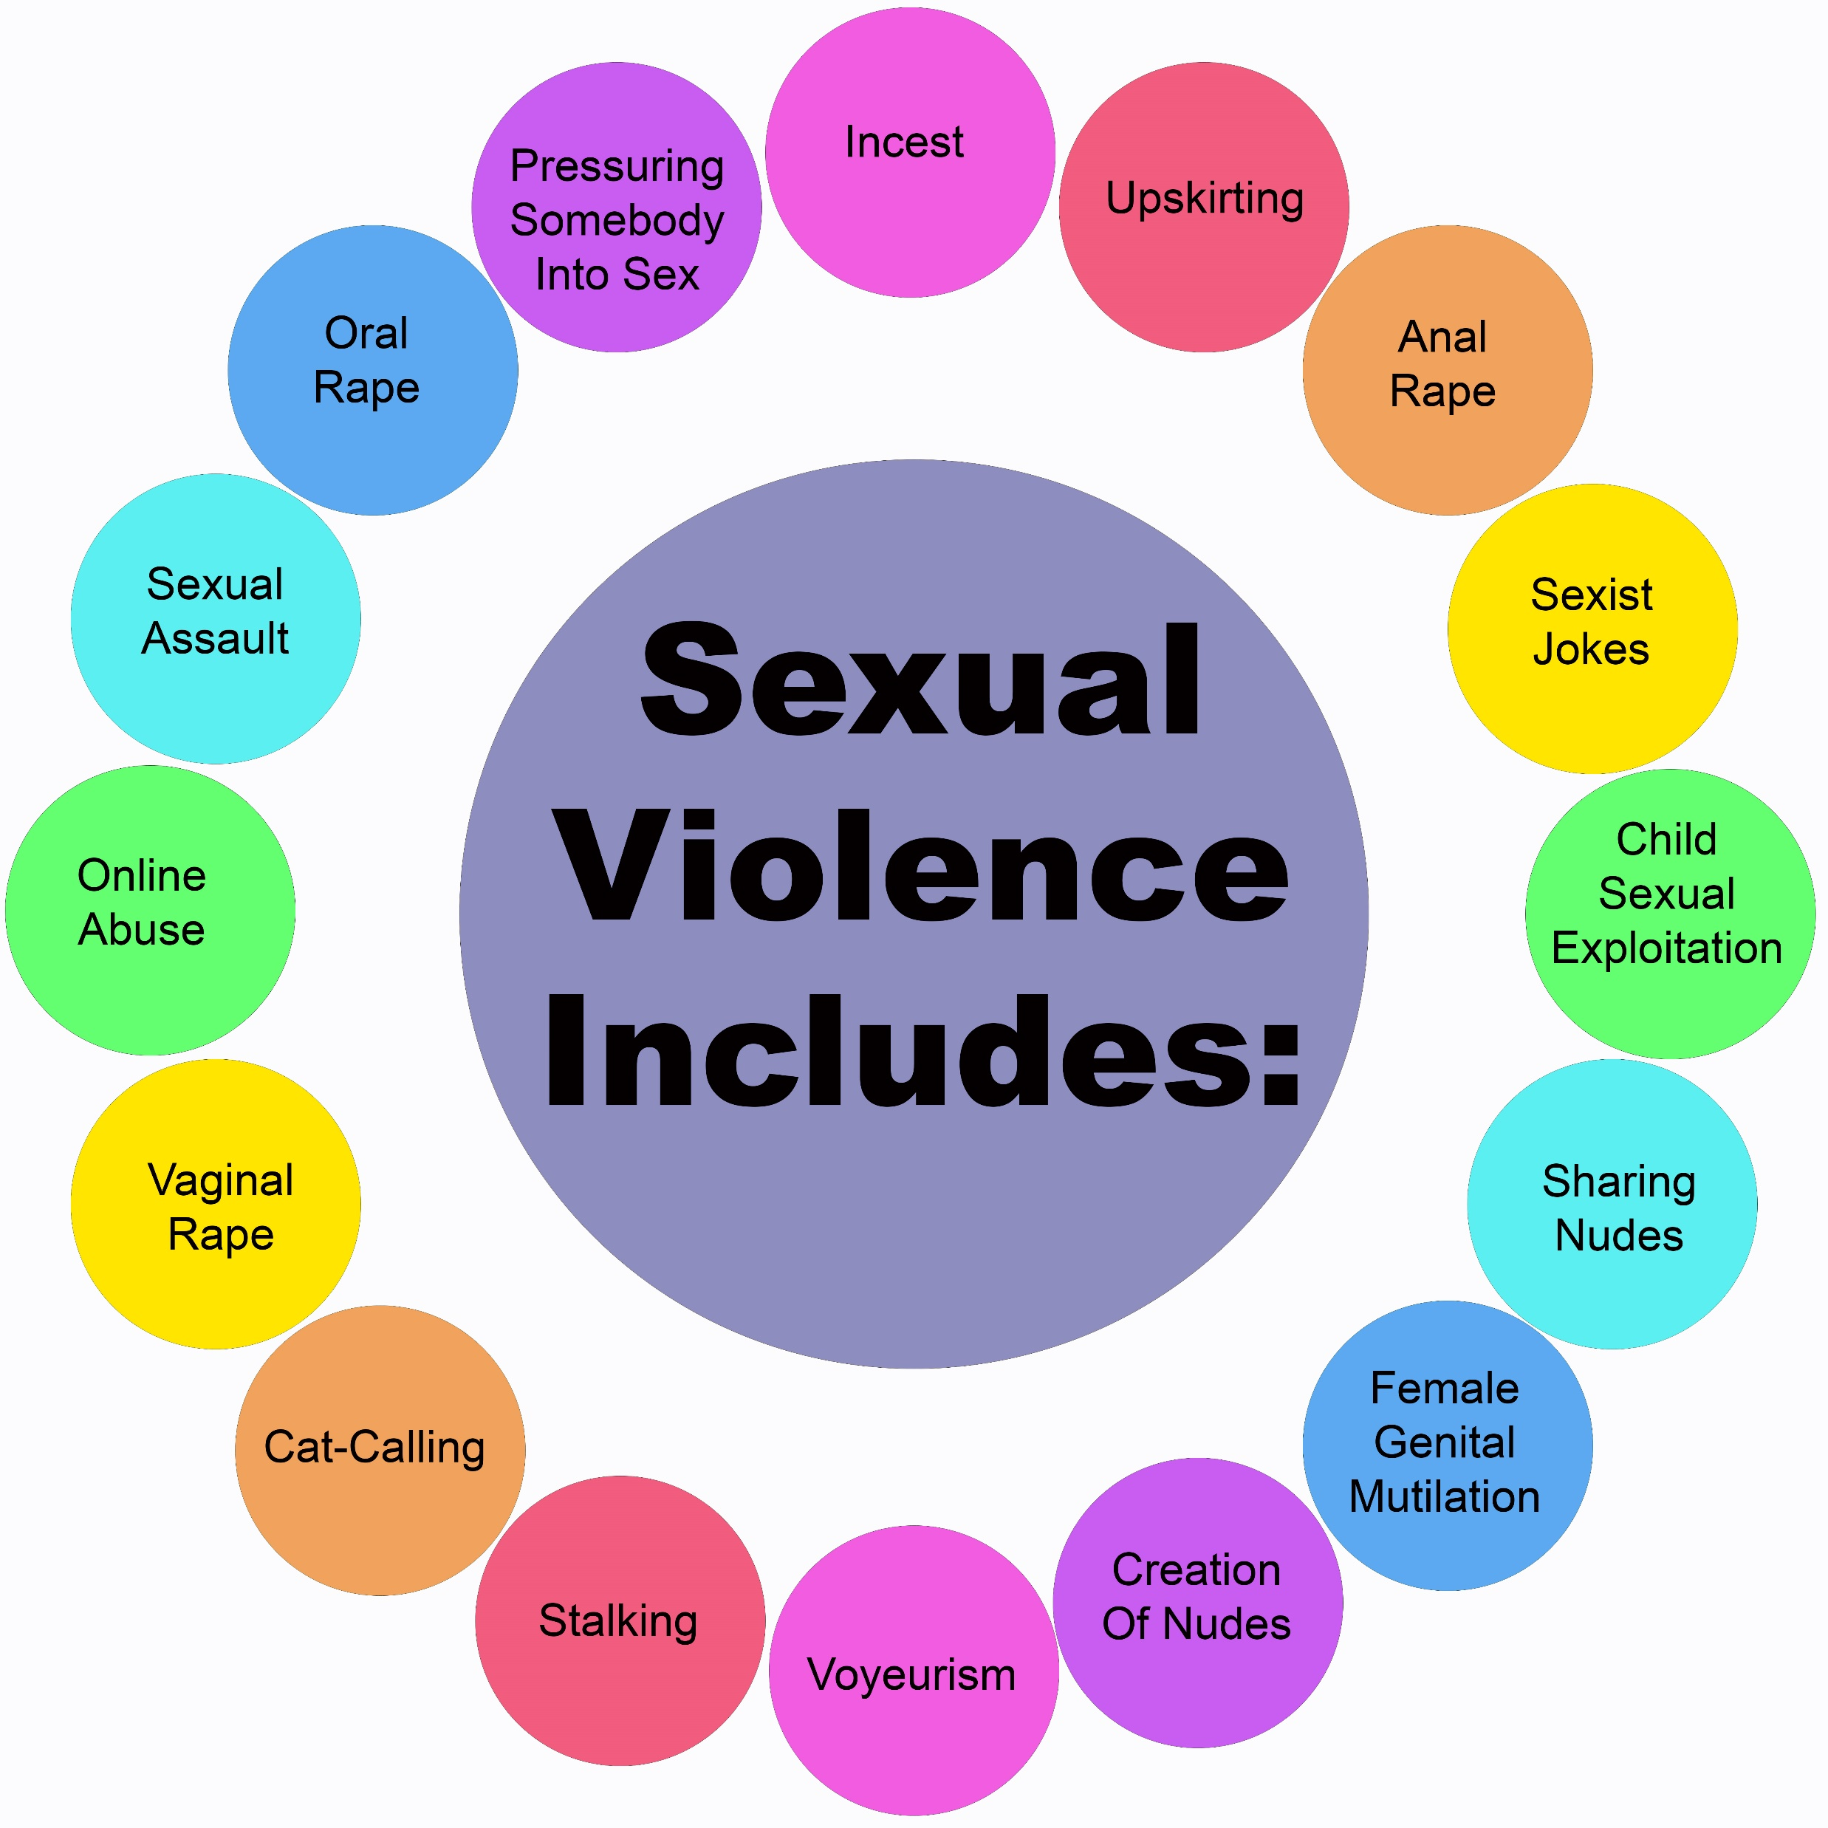

Slide 12
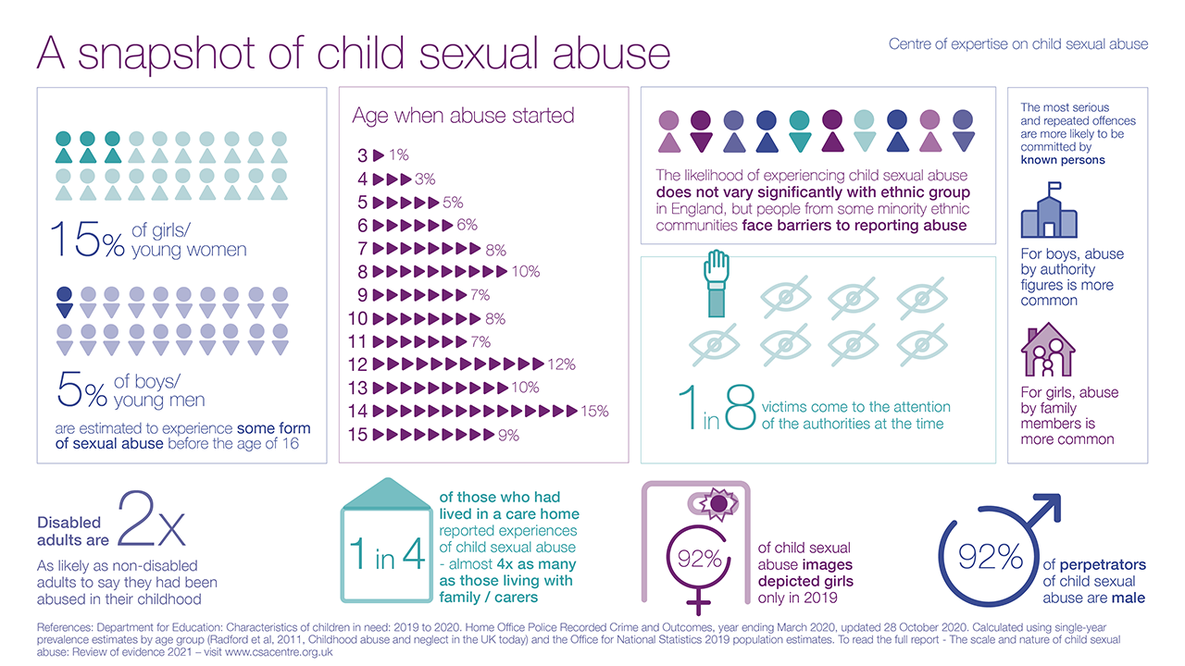

Slide 13
Case Study - Beth

Slide 14
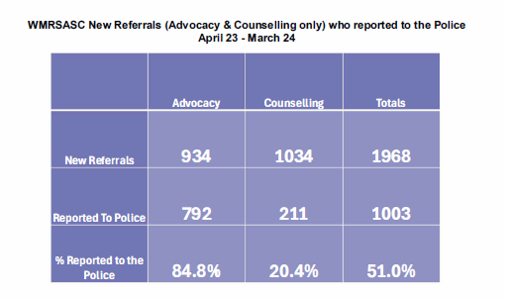
A response is needed
Number | Rape Offences
CSP | 2019/20 | 2020/21 | 2021/22 | 2022/23 | 2023/24
Herefordshire, County of | 161 | 195 | 238 | 215 | 196
Number | Other Sexual Offences
CSP | 2019/20 | 2020/21 | 2021/22 | 2022/23 | 2023/24
Herefordshire, County of | 317 | 280 | 410 | 417 | 381
New referrals Herefordshire 2023/24
268 referrals for advocacy
254 referrals for counselling
63 referrals for early intervention & prevention work
12 referrals for the Pathfinder project.
597

