Slide 1
Peer on Peer Abuse – Introducing Herefordshire’s Multi-agency Guidance Herefordshire Safeguarding Children Partnership February 2022

Slide 2
Introduction & Aims
On 21 January, 2022, Herefordshire Safeguarding Children Partnership published a new guidance for multi-agency professionals about Peer on Peer Abuse
We will present:
Introduction to the guidance
Scenarios
How to access the guidance
Notes:
Aims of the presentation –

Slide 3
Recent Child Safeguarding Practice Review: Peer on Peer Abuse
On 21 February, 2022, the HSCP published CSPR Peer on Peer Abuse
The CSPR that was undertaken identified that the learning related to ‘Peer on Peer Abuse’
It was recognised that there was multi-agency learning in the ways agencies had worked together following the allegations.

Slide 4
Herefordshire Safeguarding Children Partnership Peer on Peer Abuse Multi-agency Guidance
Created by the Herefordshire Safeguarding Children Partnership
Produced in line with statutory guidance from the DfE – Keeping Children Safe in Education Act 2021, the Children Act 1989 (section 11), and Working Together to Safeguard Children 2018

Slide 5
Why a multi-agency guidance for Herefordshire?
Response to learning that identified ‘peer on peer abuse’
Establish a consistent and informed approach
Support all front-line practitioners to recognise and respond
Encourage a contextual, multi-agency approach to identify, prevent and respond to peer-on-peer abuse

Slide 6
Why is this important?
Research tells us:
a significant minority of young people in the UK will be abused by another young person before they turn 18.
a third of child sexual exploitation cases nationally are peer-on-peer, and
surveys of school-aged children have found that up to a third of young women report experiencing sexual violence from a partner before they turn 18, a quarter report physical abuse, and close to half report emotional and online abuse.
The suggestion is that peer-on-peer abuse is one of the most common forms of abuse affecting children in the UK currently.
We take instances of peer abuse as seriously as abuse perpetrated by adults.
Notes:
References:
- a significant minority of young people in the UK will be abused by another young person before they turn 18 (Barnardo’s, 2011; Barter et al., 2009, 2015; Corr, 2013; Firmin, 2015).
- surveys of school-aged children have found that up to a third of young women report experiencing sexual violence from a partner before they turn 18, a quarter report physical abuse, and close to half report emotional and online abuse (Barter et al., 2015; Corr, 2013; Pearce and Pitts, 2011).

Slide 7
What is Peer on Peer Abuse?
Peer-on-peer abuse is any form of physical, sexual, emotional and financial abuse, and coercive control exercised between children, and within children’s relationships (both intimate and non-intimate), friendships, and wider peer associations.
Happens in a whole range of settings that children attend, however it often goes unseen.
All children have the capability to abuse their peers.

Slide 8
Prevalence in Herefordshire
Sept 2020-April 2021
A total of 71 referrals: 67 from police, 3 from schools, 1 from ambulance service.
Out of these incidents, 18 have occurred within school, 53 outside of school
37 have been physical, 20 sexual, 12 verbal abuse, 5 bullying (please note that some incidents have been categorised under more than 1 of these due to the nature of the incident)

Slide 9
Prevalence in Herefordshire Continued….
Of the 20 sexual incidents, 15 occurred amongst children attending the same school;
9 are logged as violence
7 are logged as harassment
1 is logged as sexual images
1 is logged as sexual bullying.
Incidents which sexual peer on peer abuse occurred and pupils do not attend the same setting are logged as;
2 sexual violence
3 sexual harassment.
4 incidents occurred on school grounds, and all of the incidents have occurred in secondary schools.
42 incidents have involved children from the same school, 29 from different schools

Slide 10
Scenario 1
A group of year 6 primary aged children, all in the same class are part of a whatsapp group. There have been some posts shared with the DSL by a parent of a child in the group. The posts are of a concern as they involve several children using unkind names to her daughter, as well as threats being made to hurt her when they play in the local park after school. The parent wants the DSL to take action as a result of these posts and have asked school to investigate and consider excluding the child.

Slide 11
Scenario 2
A year 10 female student has disclosed a sexual assault as caused by a year 11 male student, within school. She describes how when walking to her lesson, the student has walked in front of her and grabbed both breasts. She is petrified of coming in to contact with the male, for fear of any further incidents happening

Slide 12
Scenario 3
Whilst at the local park, a group of year 7 children have been threatened and called names by older children who they don’t recognise from their school. Whilst trying to walk off, one of the older children has punched the younger children in the back, causing bruising and pain.

Slide 13
Forms of Peer on Peer Abuse
Peer on Peer can include, but is not limited to:
serious bullying (including cyberbullying)
teenage relationship abuse or domestic violence
physical abuse such as hitting, kicking, shaking, biting, hair pulling, or otherwise causing physical harm
up skirting
sexting
initiation/hazing type violence and rituals
child exploitation, ie gang related activity and serious youth violence, criminal and sexual exploitation, trafficking, modern slavery
harmful sexual behaviour and/or
prejudice-based violence including, but not limited to, gender-based violence
Online peer-on-peer abuse (any form of peer-on-peer abuse with a digital element, for example, sexting, online abuse, coercion and exploitation, peer-on-peer grooming, threatening language delivered via online means, the distribution of sexualised content, and harassment.)

Slide 14
Remember…
Young people’s relationships can be hidden, less visible, change rapidly, and abuse can escalate quickly
Abuse affects children very differently. Rather than checking behaviour against a list:
be alert to behaviour that might cause concerns,
think about what the behaviour might signify
speak to children and encourage them to share any underlying reasons for their behaviour, and, where appropriate, to engage with their parents/carers so that the cause(s) of their behaviour can be investigated.

Slide 15
Learning from CSPR Peer on Peer Abuse
Importance of considering the needs and risk to both the child who has harmed and the child who caused harm – for e.g. separate Strategy Meetings if the threshold for significant harm is met, and Child and Family Assessment considered for each child
When speaking with a young person about their sexual activity, use specific language and provide opportunity to speak with the young person alone without a parent or carer
There is a need for stronger use of the Professional Differences Policy when there is disagreement about a decision that has been made by another professional
The full report and learning briefing are available on the HSCP website here
Notes:
https://herefordshiresafeguardingboards.org.uk/herefordshire-safeguarding-children-partnership/for-professionals/child-safeguarding-practice-reviews/

Slide 16
Key principles
We use the terms “children who are harmed” and “children who cause harm” instead of “victim” and “perpetrator”
Children who are harmed, and children who cause harm, should both be considered as children in need
A child who is abused or witnesses abuse and / or violence may feel helpless and humiliated, may blame themselves, and find it difficult to develop and maintain a sense of self-worth.
Children who cause harm others should be held responsible for their abusive behaviour, while being identified and responded to in a way that meets their needs as well as protecting others.

Slide 17
If you are concerned about a child…
Discuss with your organisation’s senior officer (designated safeguarding lead / line manager, etc)
Refer to the Herefordshire levels of need guidance (Right Help, Right Time framework) to determine the most appropriate approach
You become aware of a possible child at risk
If you believe that a child is at risk of significant harm, always make an immediate referral to MASH; or if there is an immediate risk of death or serious injury dial 999
If you don’t believe that a statutory referral is needed at Level 4, follow Right Help, Right Time procedures for Level 2 or Level 3 support.
A multi-agency strategy meeting should be convened within one working day where the threshold for significant harm is met for either child.
Notes:
MASH: (01432) 260800
MASH Emergency Duty Team (01905) 768020 (out of hours number for when MASH are unavailable)
The purpose and value of a strategy discussion
7.18 The purpose of strategy discussions is to share information in order to decide whether to start an enquiry into concerns about significant harm (Section 47 Children’s Act 1989), to inform any criminal investigation and to agree any safety plans required to protect the child in the immediate. If a Section 47 is progressed the strategy discussion will plan the enquiry and monitor its progress. Strategy discussions should be thought of as a process rather than a one-off event. They are the means for keeping relevant professionals involved in a child protection enquiry.
See the guidance for more instruction on convening strategy meeting and what to do next

Slide 18
Immediate response – top tips
Stay calm – be aware of your body language
Reassure
Observe & listen – let the child speak freely
Do not promise confidentiality
Tell the child (or parent, etc.) what will happen next
Record & refer appropriately
Seek support & listen to the child, to put in place the best plan for support and protection
Get help and advice – speak with you Designated Safeguarding Lead, line manager, or other professionals
Refer to the guidance!

Slide 19
Findings of HSCP multi-agency audit on Peer on Peer Abuse (Sept 2021)
What was working well?
The majority of the referrals into MASH had been referred at the correct level in accordance with Right Help, Right Time
The Voice of the Child was clearly demonstrated in the majority of the cohort
Schools demonstrated good knowledge of risk assessments and safety planning & there was evidence that risk assessment and safety planning had been completed for other children through Child and Family assessments and Early Help.
Notes:
Herefordshire Safeguarding Children Partnership Audit – September 2021

Slide 20
Findings of HSCP multi-agency audit on Peer on Peer Abuse (Sept 2021)
What were we worried about?
In the majority of cases audited, Strategy meetings were not convened.
There appears to have been a lack of robust multiagency working or acknowledgment that peer on peer abuse needs to be addressed through contextual safeguarding.
A lack of consistent approach and standardised use of process.
Notes:
Herefordshire Safeguarding Children Partnership Audit – September 2021

Slide 21
What else will you find in the Peer on Peer Abuse Multi-Agency guidance…
Definitions
Signs and symptoms
Understanding sexual behaviour in children & age-appropriate sexual development in children
What you should do – more specific procedures and guidance for all professionals
Domestic Abuse in peer relationships
Information about vulnerable groups
Managing Peer on Peer abuse within an education setting
Guidance on risk assessment, separating children, prevention, and more….!

Slide 22
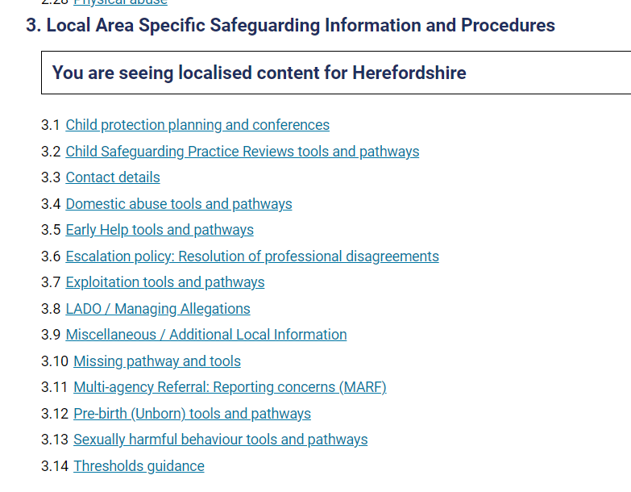
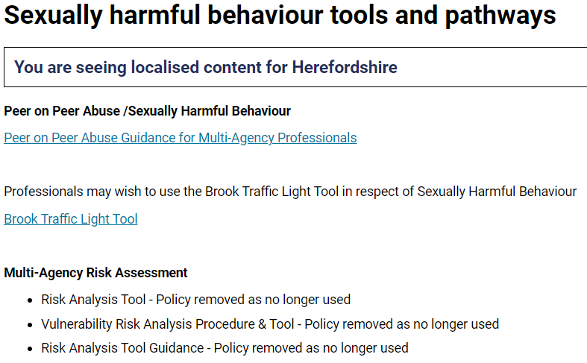
Access the guidance on the West Midlands Child Protection Procedures: Welcome | West Midlands Safeguarding Children Group (procedures.org.uk)
Select Herefordshire and scroll to section 3.13

Slide 23
Further reading & resources
1. Peer on Peer Abuse Multi-Agency Guidance – Herefordshire
2. Ofsted June 2021 Review of sexual abuse in schools and colleges
3. Centre of Expertise on CSA 2018 Di McNeish and Sara Scott Key messages from research on children and young people who display harmful sexual behaviour
4. NSPCC Research and Resources Protecting Children from Peer on Peer Sexual Abuse
5. Farrer & Co - Peer on Peer Abuse Toolkit

Slide 24
Thank you Questions or feedback?

